Slide 1
WHITE CANE
Developed by
Vinay singh
&
Raju sherla

Slide 2
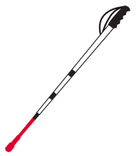
Definition of white cane
the device used by many people who are blind or visually impaired.
A white cane primarily allows its user to scan their surrounding for obstacles or orientation marks.

Slide 3

What ,why and how???
IT is a game for blind or visually impaired people
Less availability of entertainment sources in gamming sector.
Basically player have to react according to the voice output . (if he fails he loss)

Slide 4



Basic information
Language - python
Screen size - 700 * 420 (140*3)
Imported library – pygame
keys required to play-
UP arrow
DOWN arrow
LEFT arrow
RIGHT arrow
SPACE key

Slide 5
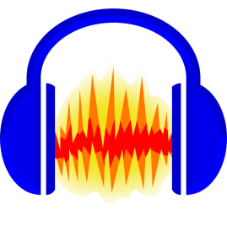
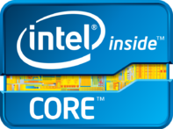




Software & Hardware requirement
Software Requirement
Operating System Windows 7 or Above
Python
Photoshop
Photo Editing Tool
Audio Editing Tool
Browser
Hardware Requirement
1. Processor: Intel Pentium 4 (Or) Higher
2. RAM: 512 Mb & Above hard
3. Disk Drive: 500 Mb Or Above
4. Speakers
5. Functional keyboard

Slide 6
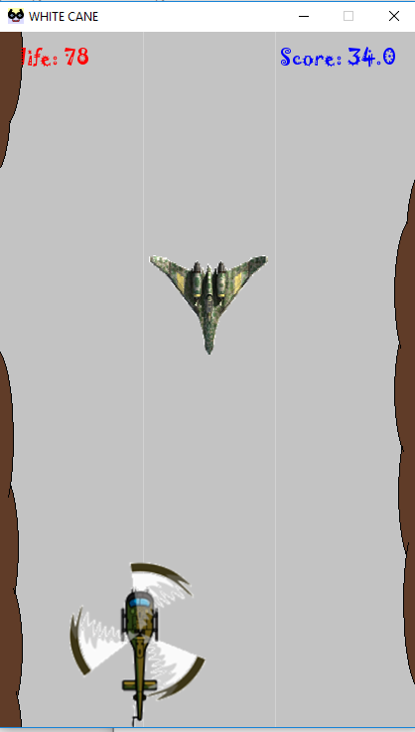
Game Interface
Icon
Name
Life
Score
Helicopter
Enemy plane
Background

Slide 7
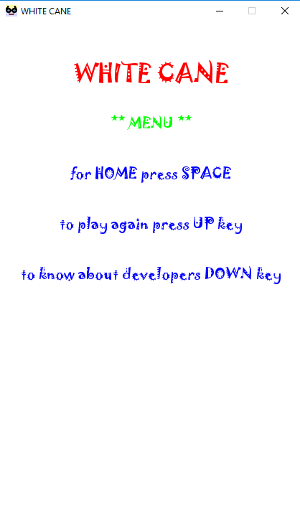

menu

Slide 8
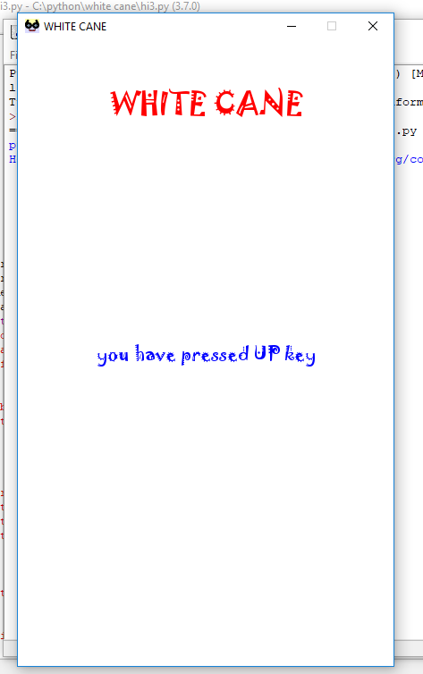
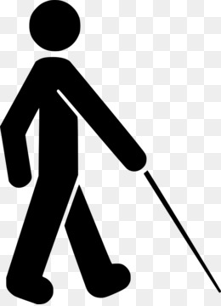
Introduction module
Up key
Down key
Left key
Right key
Space key

Slide 9
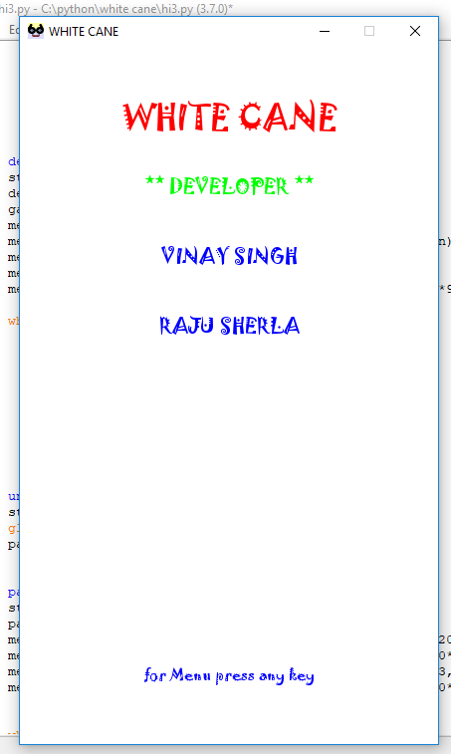
developer

Slide 10
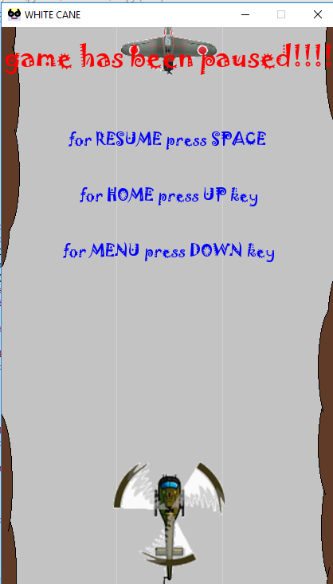
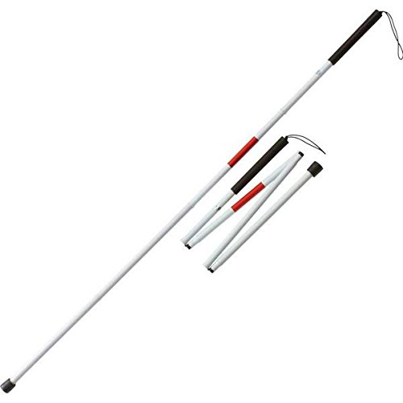

Pause Event

Slide 11
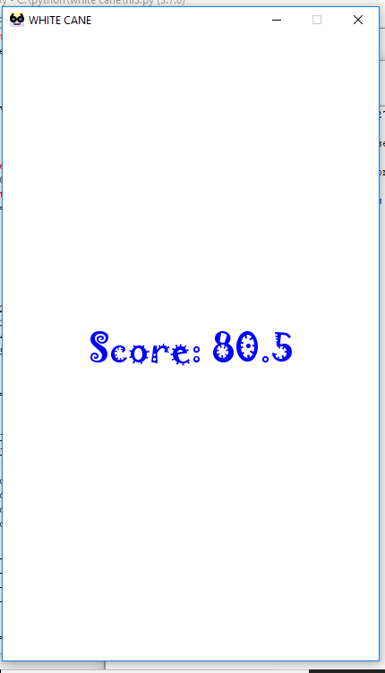
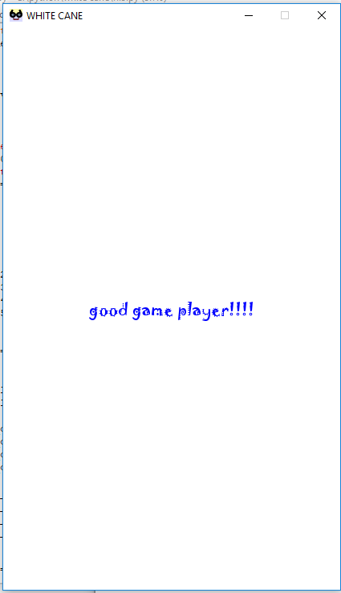
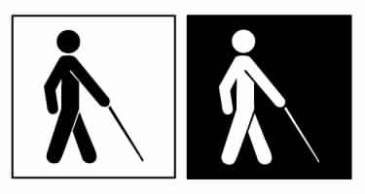
Score
When player loss the game.
Compliment as per the score

Slide 12
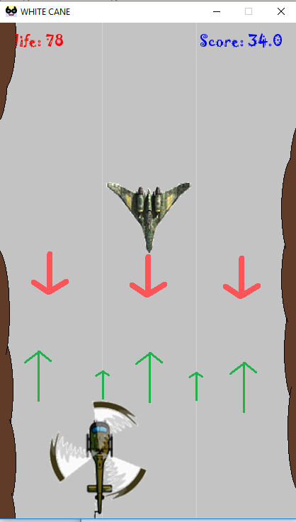

Description of possibility

Slide 13
Its all about VOICE
Total number of .wav file- 55/77
4 to 5 different type of voice (APP-voice changer)
Simple
Robot
Small creature
Alien
Everything is spinning

Slide 14
Things that is been used other than python
Notepad ++
Gimp
Android application-
Pygame docs
Pygame tutorial and compiler
Sololearn
Voice changer
Voice editor
Youtube
T2S
Mp3 to wav converter
Quora etc
Murach’s python programming (book)
IYOC games with python (pdf book)
MS picture manager
MS Power point
Paint

Slide 15



Future Enhancement
Multiplayer game
Online development
Database implementation
Global record of player
Multi level implementation
More user interactive
Multi platform development

Slide 16
THANK YOU

